Slide 1
Omney CPA
K. Bharat & Co.
Chartered Accountants
Omney CPA
Public Accounting Firm

Slide 2
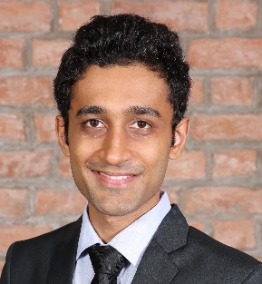
Omney CPA
About us
About the firm
K. Bharat & Co., Chartered Accountants is a practicing CA firm based in Mumbai, India.
Omney CPA is a licensed US CPA firm.
Omney provides attest, tax and accounting services to businesses and high net worth individuals.
Omney has offices in Atlanta, GA and Mumbai, India, and has a team strength of 30+ skilled professionals.
Kevin Darji, CPA – Managing Principal
Kevin is a seasoned professional having 10+ years of experience serving clients in the financial services industry.
His expertise is in providing accounting, tax, and consulting services to dynamic companies and their owners across a variety of industries.
Kevin is a licensed CPA, MBA (IIM Ahmedabad) and CA.
Kevin has earlier worked with Goldman Sachs in Investment Banking and PwC in Mergers and Acquisitions.
This profile is only for informational purposes.

Slide 3
Omney CPA
Tax and Accounting Services (1/2)
Financial Services domain
Services to funds
PPM Audit (India)
Valuations (India)
Preparation of Schedule K-1 tax reporting for US investors
Assistance in US regulatory compliances for fund raising from US investors
FATCA / CRS Reporting
Tax Services
Tax returns for Corporations, LLCs, Partnerships, Individuals
Federal, State and Local tax returns
Consolidated returns
Complex Tax Returns of Expats
International taxation
Accounting for taxes under US GAAP (ASC 740)
Attest Services
Audit
Limited review
Compilation engagements
This profile is only for informational purposes.

Slide 4
Omney CPA
Tax and Accounting Services (2/2)
Accounting Services
Full charge bookkeeping services
Assistance to existing accounting team in specific functions / tasks
Finalization of accounts
Preparation of financial statements
Valuation and MIS Services
Business valuations
MIS reports based on requirements of Management, size & nature of business
Prepare regular reports as per required frequency
Example – Inventory movement, segmental P&L, working capital analysis
Illustrative Clientele Profile
Businesses in industries of investment funds, hedge funds, IT services, healthcare benefits management, staffing firms, education, exports, gas stations, restaurants, C-stores, etc.
Individuals who are business owners, expats, self-employed, W2 salaried, etc.
This profile is only for informational purposes.

Slide 5
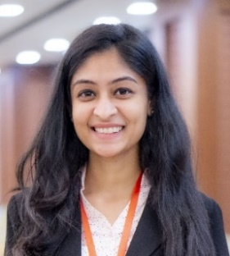
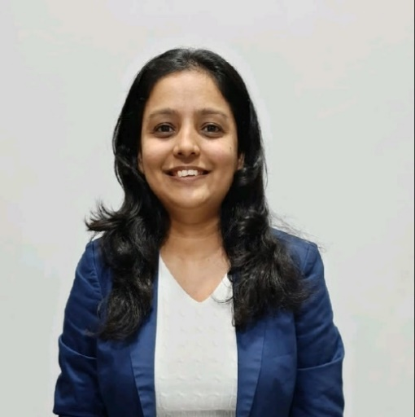
Omney CPA
Team and Contact Details
Team Leaders
Ami Chauhan
Ami leads the audit and MIS vertical in the firm. She is a CA having over 7 years of experience of serving clients from small medium business to listed companies.
Binal Darji
Binal leads the tax team in the firm. She is a practicing CA having over 15 years of experience.
Contact Details
SPOC: Kevin Darji
Phone: +91 9833 489 346 | +1 (470) 407 9621
Email: kevin@omneyservices.com
Address:
Office No. 2, 2nd Floor, Shantinath Shopping Centre, S V Road, Malad West, Mumbai – 400064, India.
8735 Dunwoody Place, Atlanta, GA 30350, USA.
This profile is only for informational purposes.

